Slide 1
Project
Akhir
Basis Data Lanjut
Sultan Argya S. F 3122600022
JAVA
UI
</>
UX

Slide 2
Restful API Using
ExpressJs and Mongoose

Slide 3
TOOLS
Express
Mongoose(ODM)
Dotenv
Nodemon
Postman

Slide 4
01
instalasi
module

Slide 5
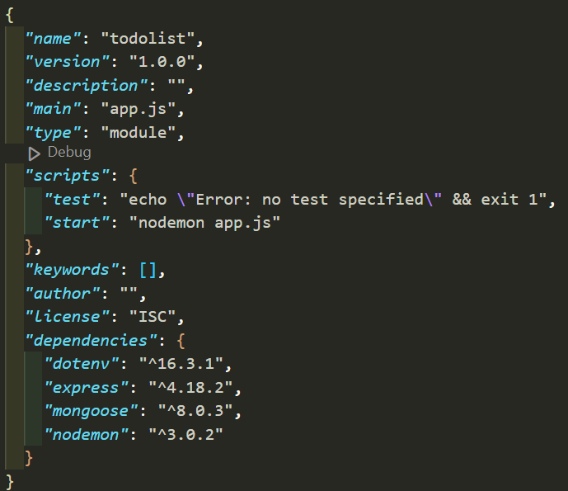
Package.json

Slide 6
02
SETUP
ENVironment

Slide 7
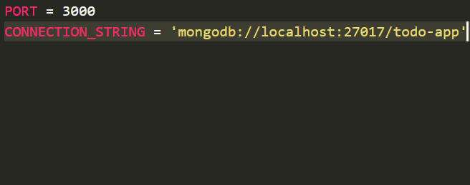
.ENV

Slide 8
03
SETUP
Connection

Slide 9
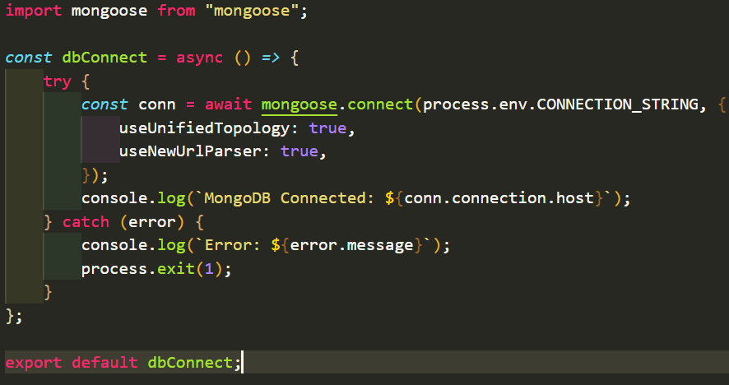
dbconnect.js

Slide 10
04
create
models

Slide 11
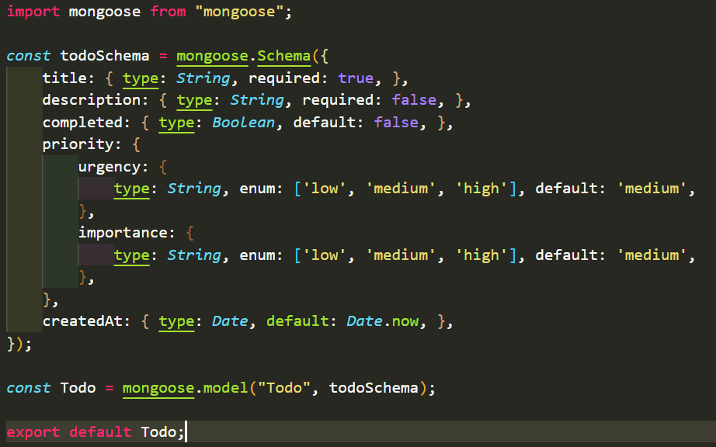
Todo.js

Slide 12
05
create
controllers

Slide 13
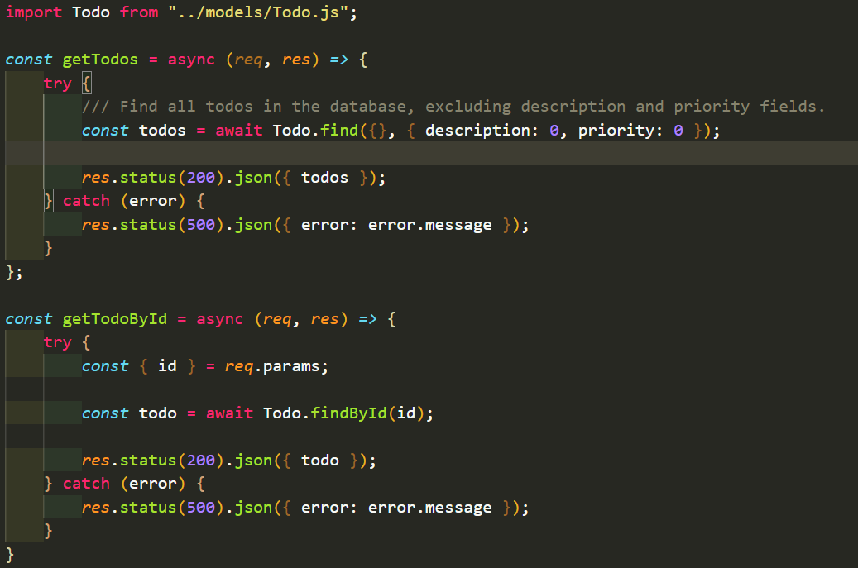
Todocontroller.js

Slide 14
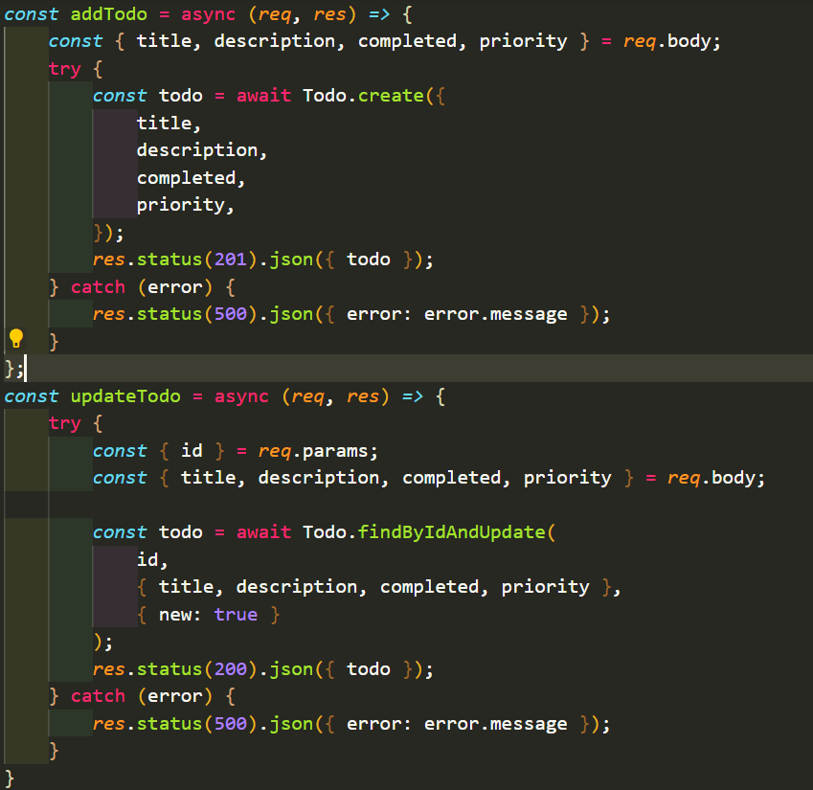
Todocontroller.js

Slide 15
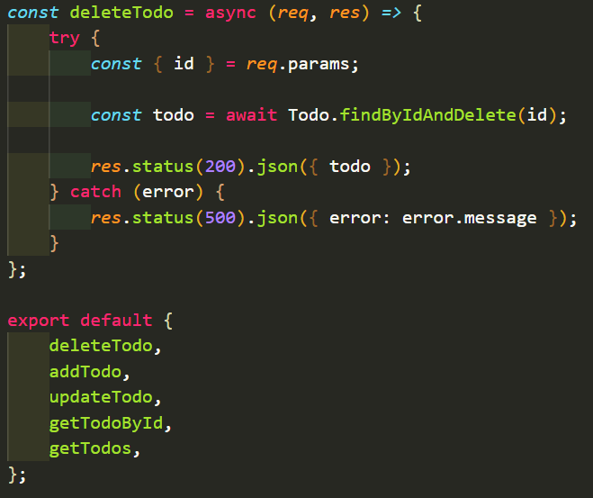
Todocontroller.js

Slide 16
06
create
routes

Slide 17
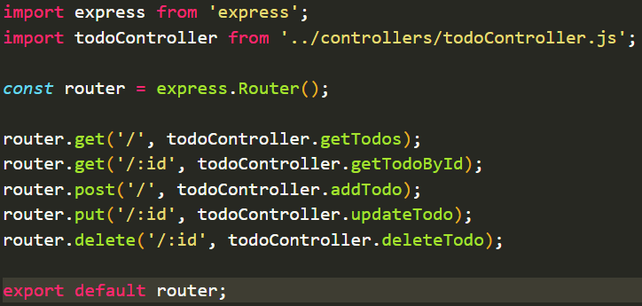
todoroute.js

Slide 18
07
SETUP
Entry point

Slide 19
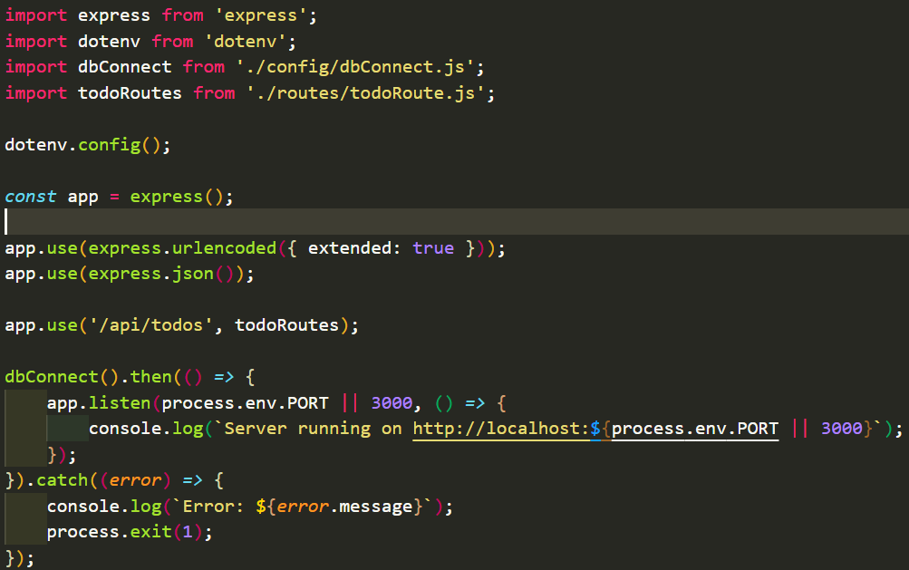
APP.js

Slide 20
08
start
server

Slide 21
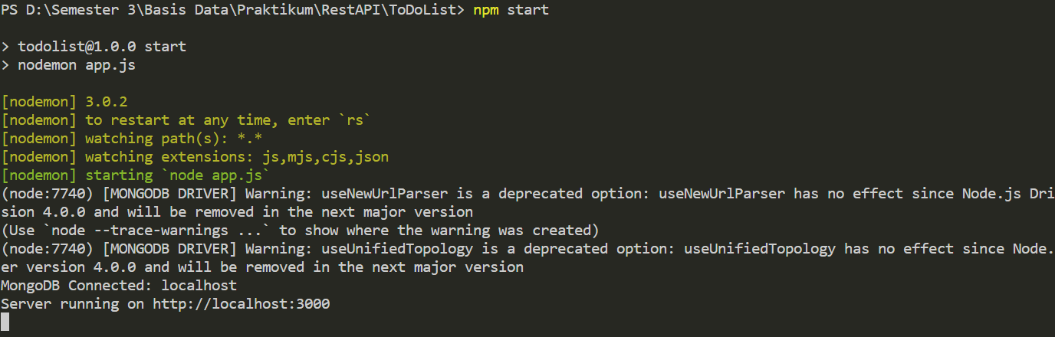
‘NPM start’

Slide 22
09
API
Testing

Slide 23
CREATE
Add document to collection

Slide 24
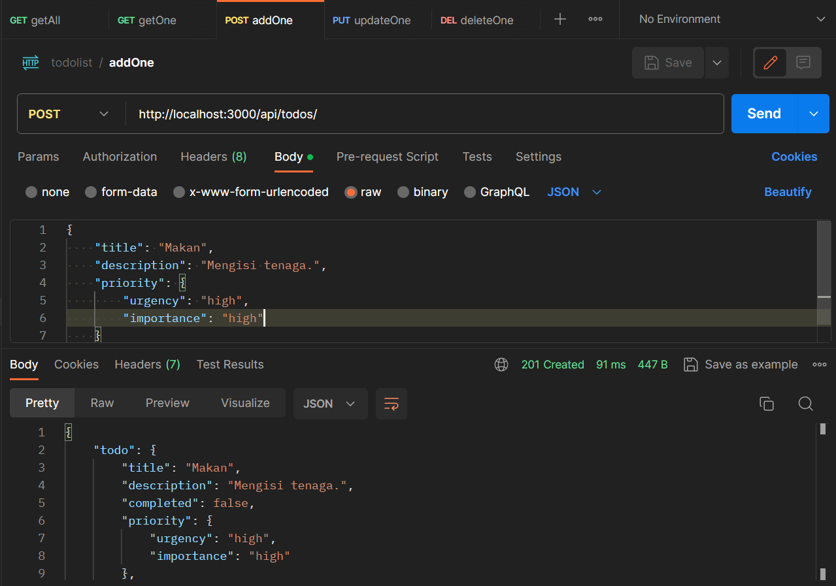
Add todo

Slide 25
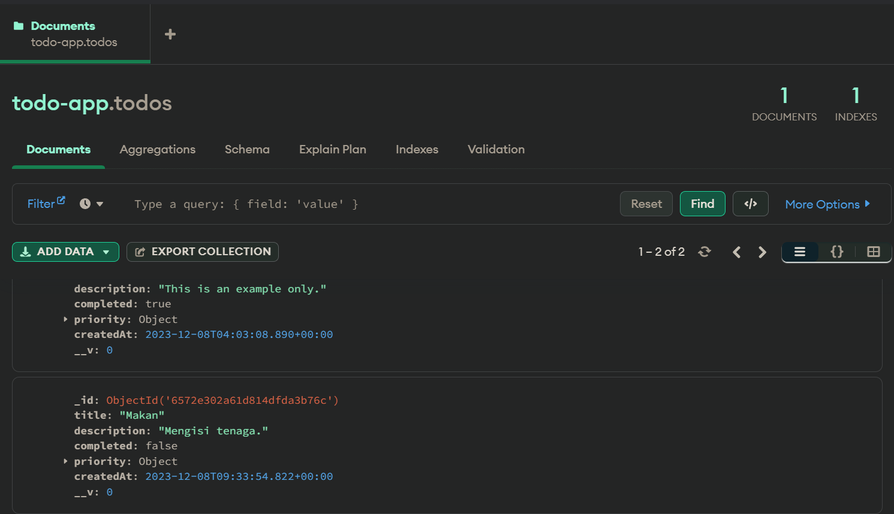
Add todo

Slide 26
READ
Get data from collection

Slide 27
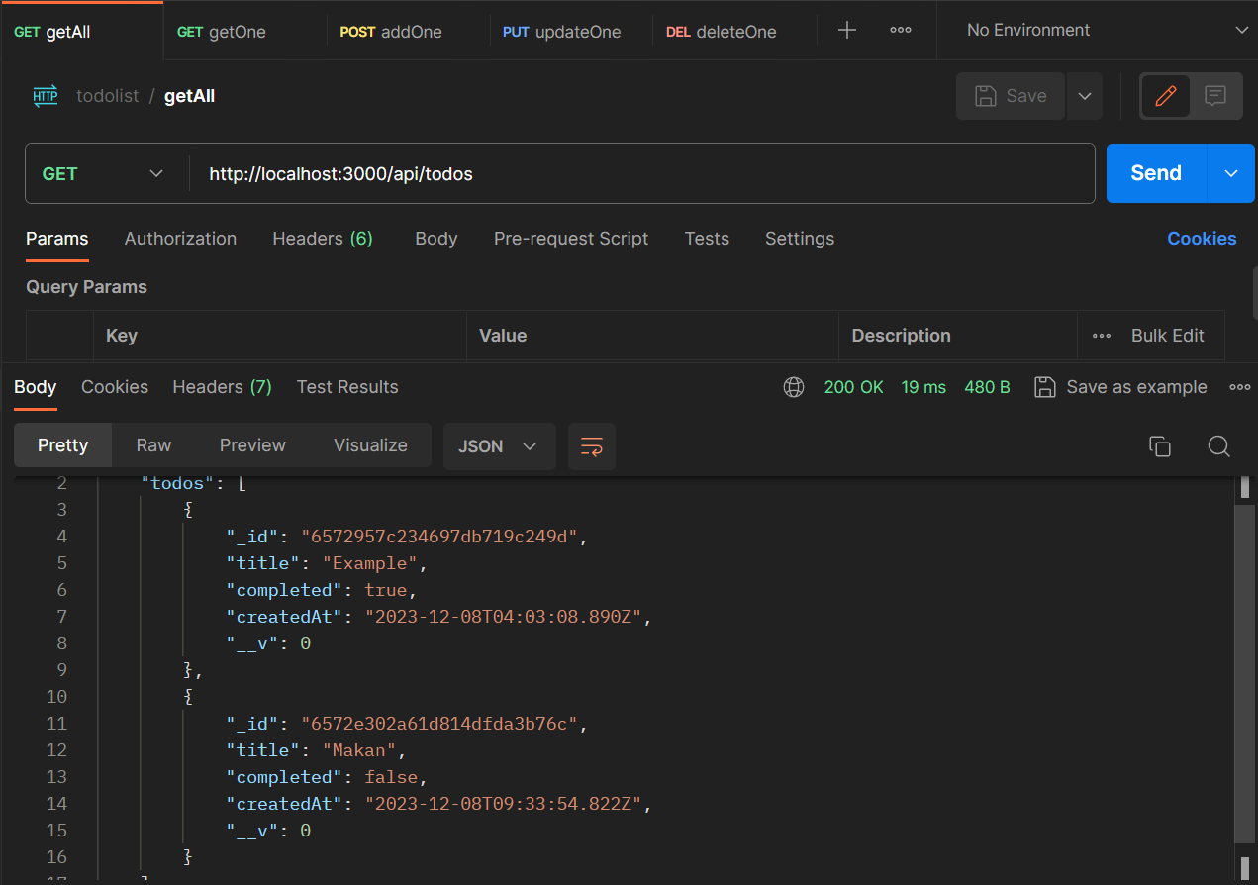
Get todos

Slide 28
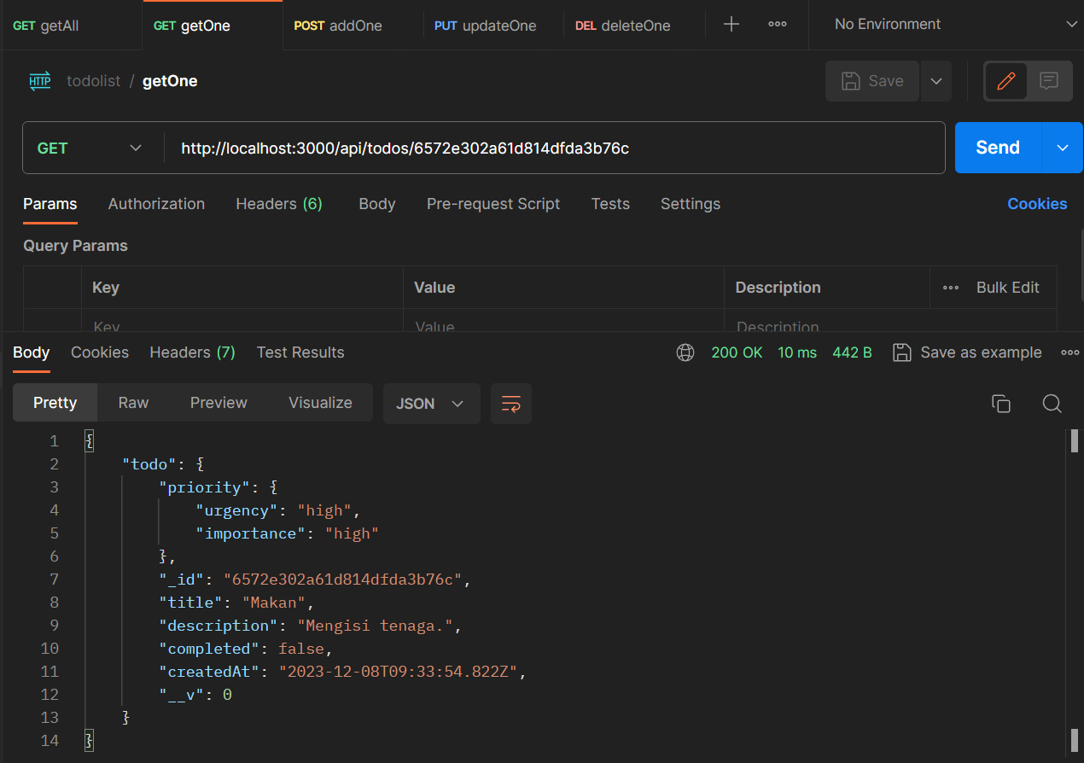
Get todo by id

Slide 29
update
Update one document from collection

Slide 30
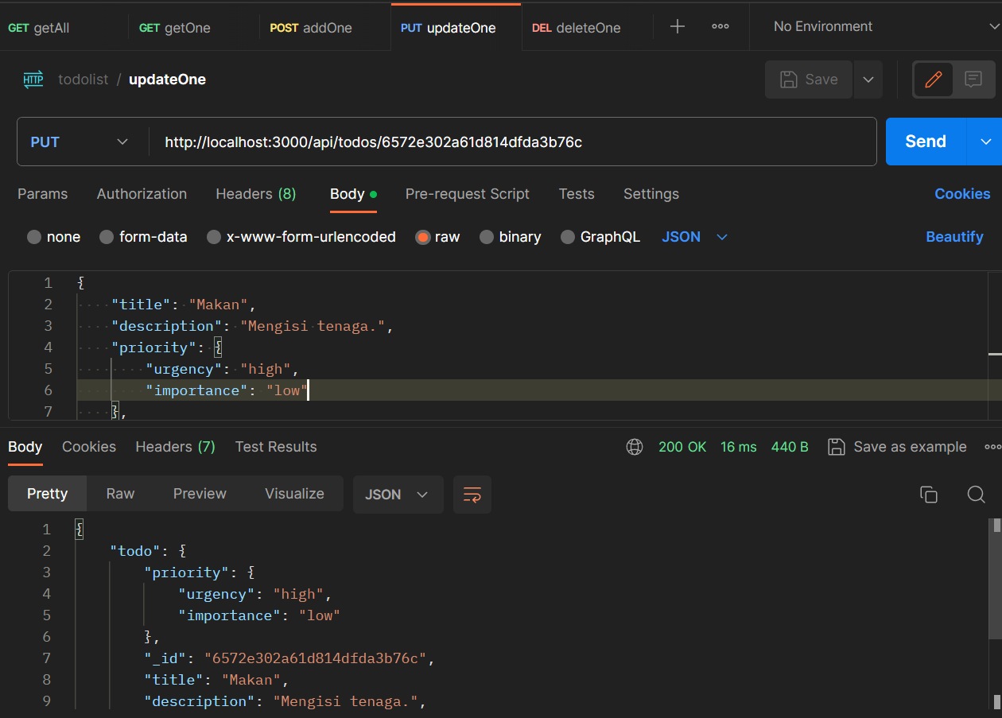
Update todo

Slide 31
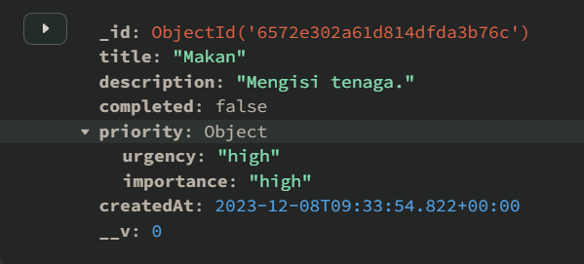
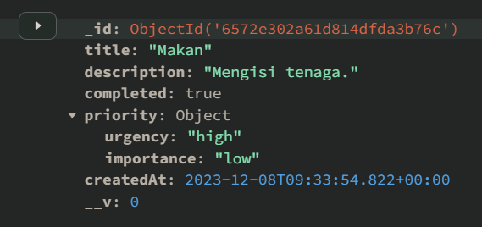
Update todo

Slide 32
DELETE
Delete one document from collection

Slide 33
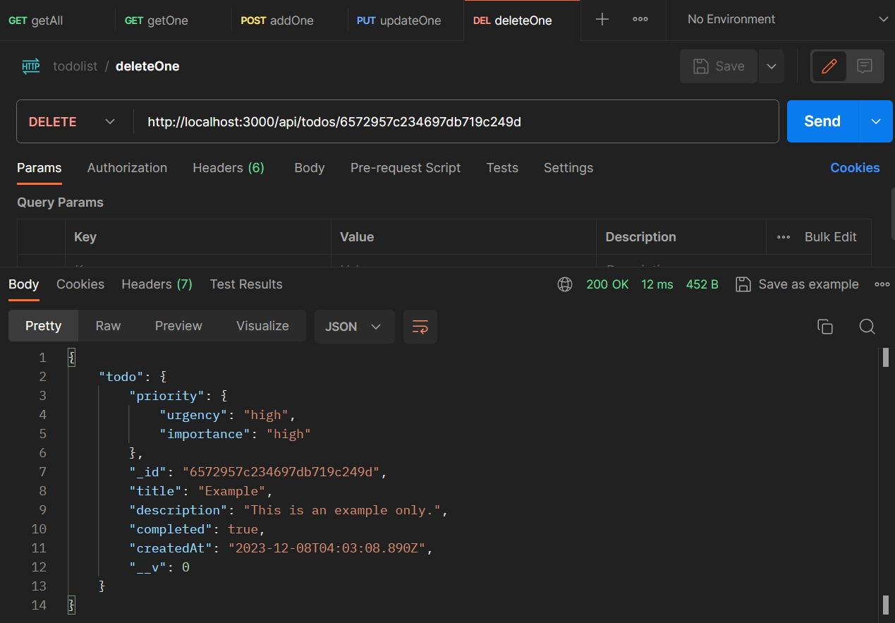
Delete todo

Slide 34
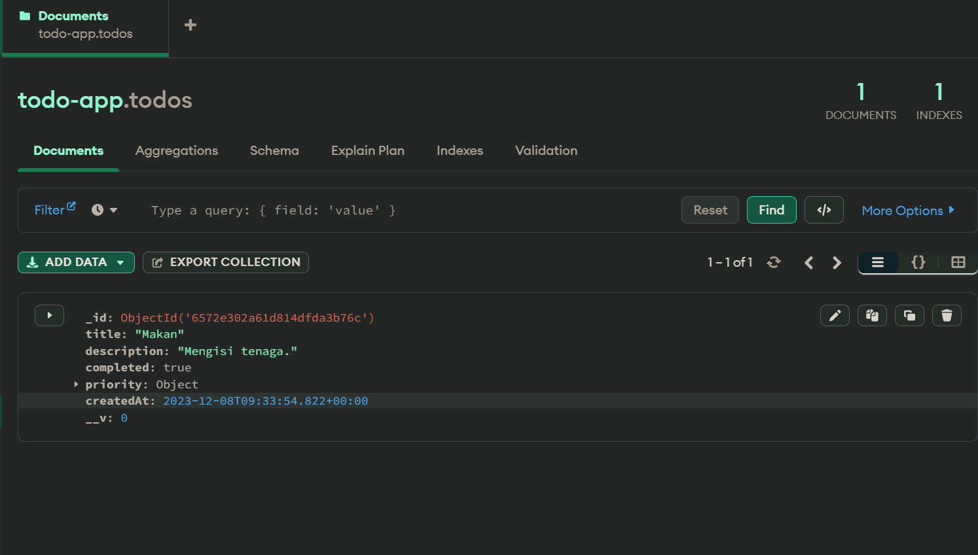
Delete todo

